Slide 1


SITA1301
PROGRAMMING IN JAVA
B.E CSE 2020-2024
III SEMESTER
Dr. A. Jesudoss
Associate Professor
Dept. of CSE
jesudossa.cse@sathyabama.ac.in
SITA2301 Programming in Java - III Sem CSE (2020-2024)
Dr. A. Jesudoss, Associate Professor, Dept. of CSE, SIST, Chennai

Slide 2
COURSE OBJECTIVES
➢ To implement Object Oriented concepts in Java.
➢ To implement Packages, Interfaces and Multithreading Concepts.
➢ To develop applications using lang and io packages.
➢ To design web based application.
➢ To design GUI application design using swing controls.
SITA2301 Programming in Java - III Sem CSE (2020-2024) Dr. A. Jesudoss, Associate Professor, Dept. of CSE, SIST, Chennai

Slide 3
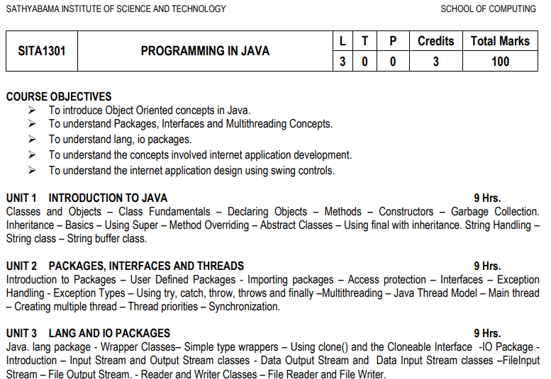
SITA2301 Programming in Java - III Sem CSE (2020-2024) Dr. A. Jesudoss, Associate Professor, Dept. of CSE, SIST, Chennai

Slide 4
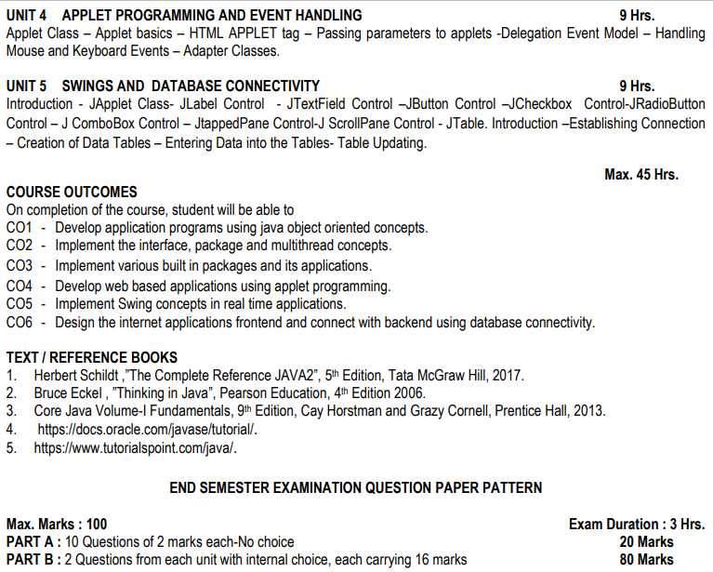
SITA2301 Programming in Java - III Sem CSE (2020-2024) Dr. A. Jesudoss, Associate Professor, Dept. of CSE, SIST, Chennai

Slide 5
UNIT IV
APPLET CLASS
APPLET BASICS
HTML APPLET TAG
PASSING PARAMETERS TO APPLETS
DELEGATION EVENT MODEL
HANDLING MOUSE AND KEYBOARD EVENTS
ADAPTER CLASSES
SITA2301 Programming in Java - III Sem CSE (2020-2024) Dr. A. Jesudoss, Associate Professor, Dept. of CSE, SIST, Chennai

Slide 6
APPLETS
Applets are small Java applications that can be accessed on an Internet server, transported over Internet, and can be automatically installed and run as apart of a web document.
Any applet in Java is a class that extends the java.applet.Applet class.
SITA2301 Programming in Java - III Sem CSE (2020-2024) Dr. A. Jesudoss, Associate Professor, Dept. of CSE, SIST, Chennai

Slide 7
APPLETS
An applet is a Java program that can be embedded into a web page.
It runs inside the web browser and works at client side.
An applet is embedded in an HTML page using the APPLET or OBJECT tag and hosted on a web server.
Applets are used to make the web site more dynamic and entertaining.
SITA2301 Programming in Java - III Sem CSE (2020-2024) Dr. A. Jesudoss, Associate Professor, Dept. of CSE, SIST, Chennai

Slide 8
APPLETS
All applets are sub-classes (either directly or indirectly) of java.applet.Applet class.
Applets are not stand-alone programs.
Instead, they run within either a web browser or an applet viewer.
JDK provides a standard applet viewer tool called applet viewer.
In general, execution of an applet does not begin at main() method.
Output of an applet window is not performed by System.out.println().
Rather it is handled with various AWT methods, such as drawString().
SITA2301 Programming in Java - III Sem CSE (2020-2024) Dr. A. Jesudoss, Associate Professor, Dept. of CSE, SIST, Chennai

Slide 9
Applets are deprecated in JDK 9, and this method is only used when running an FX application as an Applet in a browser.
With that no longer being the case, Applet support ended in March 2019. Oracle announced in January 2016 that Applets would be deprecated in Java SE 9, and the technology was removed in Java SE 11.
SITA2301 Programming in Java - III Sem CSE (2020-2024) Dr. A. Jesudoss, Associate Professor, Dept. of CSE, SIST, Chennai

Slide 10
WHY NOT SUPPORTED?
The Java browser plug-in relies on NPAPI, which nearly all web browser vendors have omitted support for due to its age and security issues. In January 2016, Oracle announced that Java runtime environments based on JDK 9 will discontinue the browser plug-in
Netscape Plugin Application Programming Interface (NPAPI) is an application programming interface (API) that allows browser plugins to be developed. It was first developed for Netscape browsers, starting in 1995 with Netscape Navigator 2.0, but was subsequently adopted by other browsers. With the advent of HTML5, all major web browsers have removed support for 3rd party NPAPI plugins for security reasons. There are some smaller browsers such as Pale Moon and Waterfox Classic that retain support for NPAPI plugins.
SITA2301 Programming in Java - III Sem CSE (2020-2024) Dr. A. Jesudoss, Associate Professor, Dept. of CSE, SIST, Chennai

Slide 11
Chrome no longer supports NPAPI (technology required for Java applets)
The Java Plugin for web browsers relies on the cross-platform plugin architecture NPAPI, which had been supported by all major web browsers for over a decade.
Google's Chrome version 45 and above have dropped support for NPAPI, and therefore Java Plugin do not work on these browsers anymore.
SITA2301 Programming in Java - III Sem CSE (2020-2024) Dr. A. Jesudoss, Associate Professor, Dept. of CSE, SIST, Chennai

Slide 12
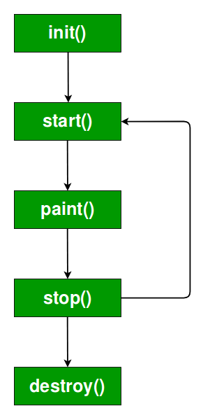
LIFE CYCLE OF AN APPLET
See the order in which methods are called
When an applet begins, the following methods are called, in this sequence:
init( )
start( )
paint( )
When an applet is terminated, the following sequence of method calls takes place:
stop( )
destroy( )
SITA2301 Programming in Java - III Sem CSE (2020-2024) Dr. A. Jesudoss, Associate Professor, Dept. of CSE, SIST, Chennai

Slide 13
LIFE CYCLE OF AN APPLET
init():
First method to be called.
To initialize an applet i.e. variables can be initialized here.
This method is called only once during the run time of your applet.
It is invoked at the time of initialization.
Initialized objects are created by the web browser.
SITA2301 Programming in Java - III Sem CSE (2020-2024) Dr. A. Jesudoss, Associate Professor, Dept. of CSE, SIST, Chennai

Slide 14
LIFE CYCLE OF AN APPLET
start():
The start( ) method is called after init( ).
start() method is used to start the applet.
It is also called to restart an applet after it has been stopped. i.e. resume
Note that init( ) is called once i.e. when the first time an applet is loaded whereas start( ) is called each time an applet’s HTML document is displayed onscreen.
SITA2301 Programming in Java - III Sem CSE (2020-2024) Dr. A. Jesudoss, Associate Professor, Dept. of CSE, SIST, Chennai

Slide 15
So, if a user leaves a web page and comes back, the applet resumes execution at start( ).
It is invoked after the init()method invoked.
It invokes each time when browser is loading or refreshing.
Until init() method is invoked start() method is inactive state.
SITA2301 Programming in Java - III Sem CSE (2020-2024) Dr. A. Jesudoss, Associate Professor, Dept. of CSE, SIST, Chennai

Slide 16
paint(): void paint(Graphics g)
{
}
paint() method is used for painting any shapes like square, rectangle, trapezium, eclipse, etc.
paint() method has one parameter of type Graphics Class
This Graphics class gives painting features in an applet.
This parameter will contain the graphics context, which describes the graphics environment in which the applet is running.
This context is used whenever output to the applet is required.
Note: This is the only method among all the method mention above, which is parameterized.
SITA2301 Programming in Java - III Sem CSE (2020-2024) Dr. A. Jesudoss, Associate Professor, Dept. of CSE, SIST, Chennai

Slide 17
stop(): - method to stop the applet.
It is invoked every time
when browser stopped or
minimized or
abrupt failure of the application.
After stop()method called, we can also start() method whenever we want.
This method mainly deals with clean up code.
The stop( ) method is called when a web browser leaves the HTML document containing the applet—when it goes to another page, for example.
When stop( ) is called, the applet is probably running. You should use stop( ) to suspend threads that don’t need to run when the applet is not visible.
You can restart them when start( ) is called if the user returns to the page.
SITA2301 Programming in Java - III Sem CSE (2020-2024) Dr. A. Jesudoss, Associate Professor, Dept. of CSE, SIST, Chennai

Slide 18
destroy():
destroy() method is used to destroy the application once we have done with our applet work.
It is invoked only once.
Once applet is destroyed we can’t start()the applet.
The destroy( ) method is called when the environment determines that your applet needs to be removed completely from memory.
At this point, you should free up any resources the applet may be using.
The stop( ) method is always called before destroy( ).
SITA2301 Programming in Java - III Sem CSE (2020-2024) Dr. A. Jesudoss, Associate Professor, Dept. of CSE, SIST, Chennai

Slide 19
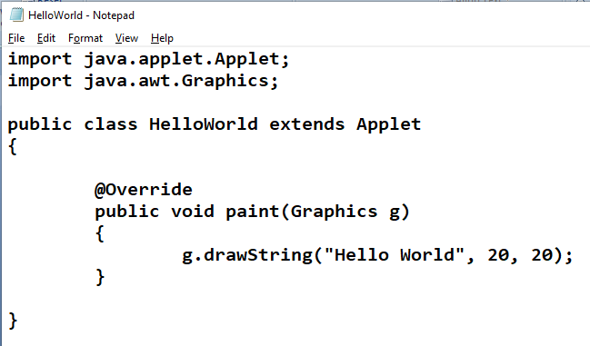
// A Hello World Applet
// Save file as HelloWorld.java
SITA2301 Programming in Java - III Sem CSE (2020-2024) Dr. A. Jesudoss, Associate Professor, Dept. of CSE, SIST, Chennai

Slide 20
This java program begins with two import statements.
The first import statement imports the Applet class from applet package.
Every AWT-based(Abstract Window Toolkit) applet that you create must be a subclass (either directly or indirectly) of Applet class.
The second statement import the Graphics class from AWT package.
SITA2301 Programming in Java - III Sem CSE (2020-2024) Dr. A. Jesudoss, Associate Professor, Dept. of CSE, SIST, Chennai

Slide 21
The next line in the program declares the class HelloWorld.
This class must be declared as public because it will be accessed by code that is outside the program. Inside HelloWorld, paint( ) is declared. This method is defined by the AWT and must be overridden by the applet.
Inside paint( ) is a call to drawString( ), which is a member of the Graphics class. This method outputs a string beginning at the specified X,Y location. It has the following general form:
void drawString(String message, int x, int y)
Here, message is the string to be output beginning at x,y. In a Java window, the upper-left corner is location 0,0. The call to drawString( ) in the applet causes the message “Hello World” to be displayed beginning at location 20,20.
SITA2301 Programming in Java - III Sem CSE (2020-2024) Dr. A. Jesudoss, Associate Professor, Dept. of CSE, SIST, Chennai

Slide 22
Notice that the applet does not have a main( ) method.
Unlike Java programs, applets do not begin execution at main( ).
In fact, most applets don’t even have a main( ) method.
Instead, an applet begins execution when the name of its class is passed to an applet viewer or to a network browser.
SITA2301 Programming in Java - III Sem CSE (2020-2024) Dr. A. Jesudoss, Associate Professor, Dept. of CSE, SIST, Chennai

Slide 23
Is @override mandatory?
@Override annotation is used when we override a method in sub class.
Generally novice developers overlook this feature as it is not mandatory to use this annotation while overriding the method.
@Override @Override annotation informs the compiler that the element is meant to override an element declared in a superclass.
While it is not required to use this annotation when overriding a method, it helps to prevent errors.
If a method marked with @Override fails to correctly override a method in one of its superclasses, the compiler generates an error.
SITA2301 Programming in Java - III Sem CSE (2020-2024) Dr. A. Jesudoss, Associate Professor, Dept. of CSE, SIST, Chennai

Slide 24
If you don't put an @Override tag, but according to the compiler you didn't override anything, you have a silent bug you don't know about. With the @Override tag, you do know about it, and you know about it NOW, not later.
You NEVER NEED to put an @Override annotation. But I'd recommend doing it every time.
In Java 5, you must not add @Override when implementing a method inherited from an interface, in Java 6, you should (or you'll get a compiler warning).
SITA2301 Programming in Java - III Sem CSE (2020-2024) Dr. A. Jesudoss, Associate Professor, Dept. of CSE, SIST, Chennai

Slide 25
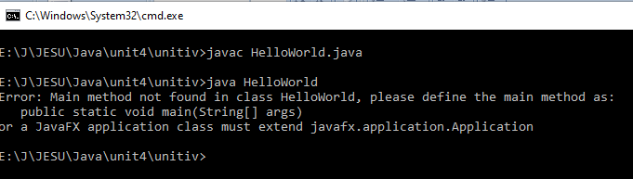
How to run Applets
After you enter the source code for HelloWorld.java, compile in the same way that you have been compiling java programs(using javac command).
However, running HelloWorld with the java command will generate an error because it is not an application.
java HelloWorld
Error: Main method not found in class HelloWorld, please define the main method as:
public static void main(String[] args)
SITA2301 Programming in Java - III Sem CSE (2020-2024) Dr. A. Jesudoss, Associate Professor, Dept. of CSE, SIST, Chennai

Slide 26
There are two standard ways in which you can run an applet :
Executing the applet within a Java-compatible web browser.
Using an applet viewer, such as the standard tool, applet-viewer.
An applet viewer executes your applet in a window. This is generally the fastest and easiest way to test your applet.
SITA2301 Programming in Java - III Sem CSE (2020-2024) Dr. A. Jesudoss, Associate Professor, Dept. of CSE, SIST, Chennai

Slide 27
Method 1: Executing the applet within a Java-compatible web browser
Hello.html
<html>
<head>
</head>
<body>
<applet code="HelloWorld" width=200 height=60>
</applet>
</body>
</html>
HelloWorld.java
How to run?
Invoke Hello.html on the browser
Hello.html will check applet tag and take class name from “code” attribute and call the HelloWorld class file
SITA2301 Programming in Java - III Sem CSE (2020-2024) Dr. A. Jesudoss, Associate Professor, Dept. of CSE, SIST, Chennai

Slide 28
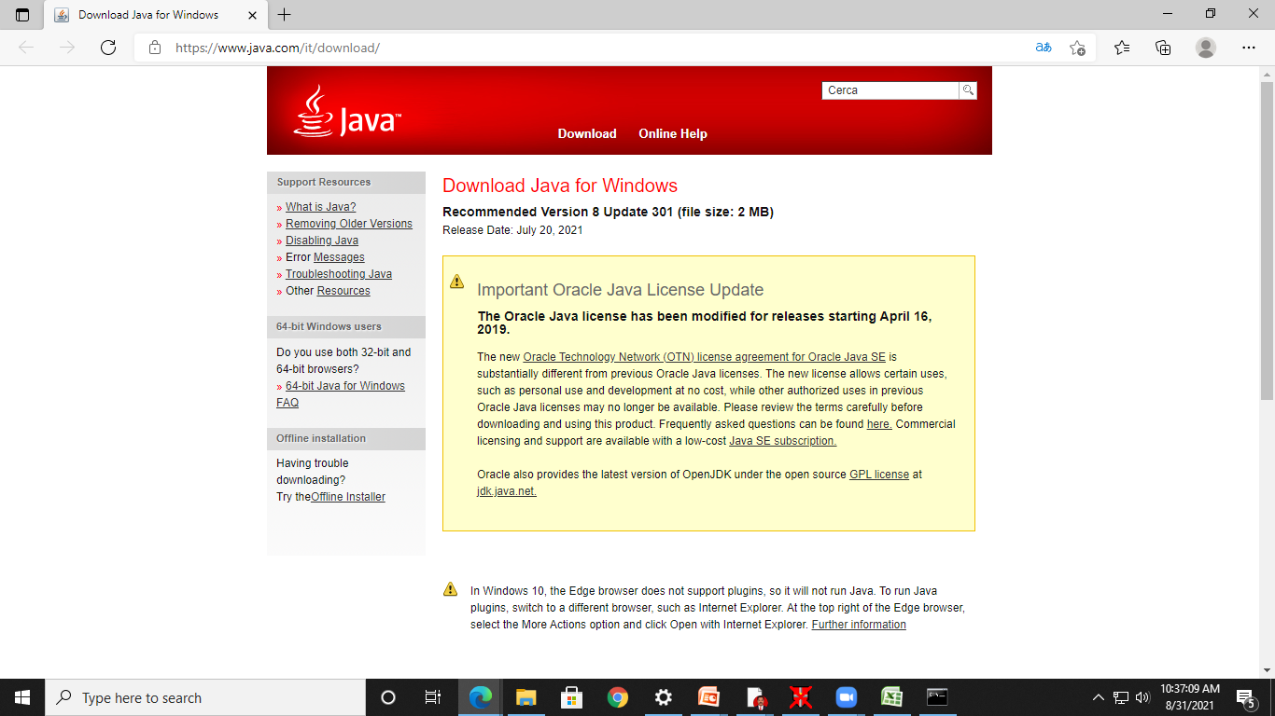
SITA2301 Programming in Java - III Sem CSE (2020-2024) Dr. A. Jesudoss, Associate Professor, Dept. of CSE, SIST, Chennai

Slide 29
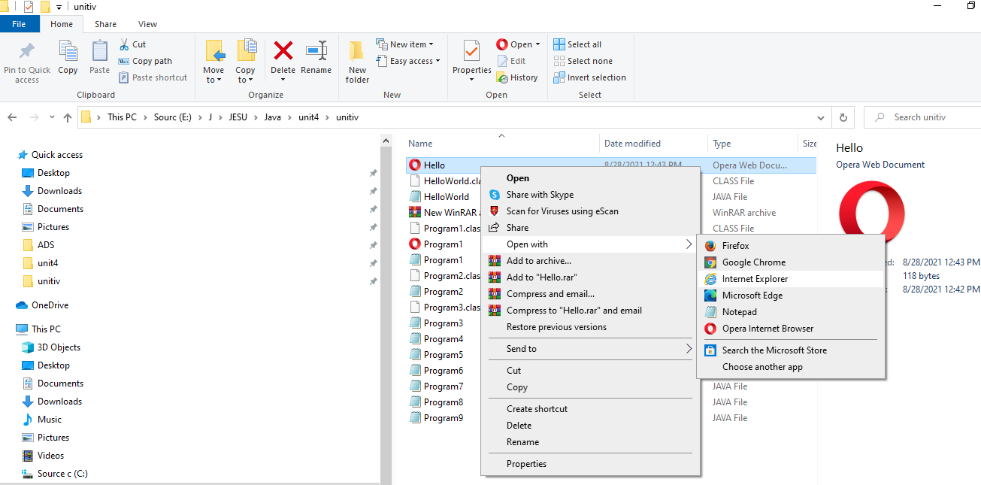
SITA2301 Programming in Java - III Sem CSE (2020-2024) Dr. A. Jesudoss, Associate Professor, Dept. of CSE, SIST, Chennai

Slide 30
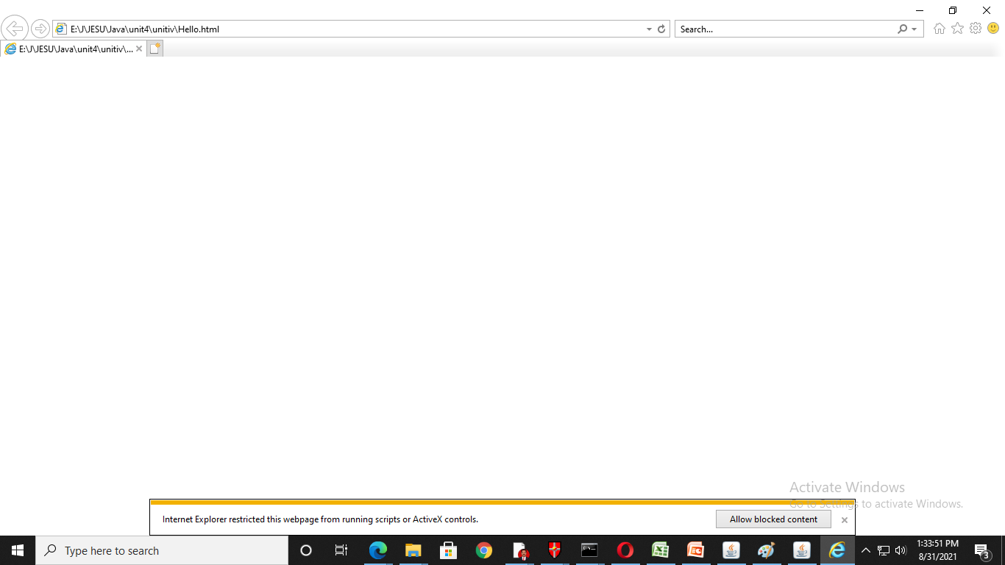
SITA2301 Programming in Java - III Sem CSE (2020-2024) Dr. A. Jesudoss, Associate Professor, Dept. of CSE, SIST, Chennai

Slide 31
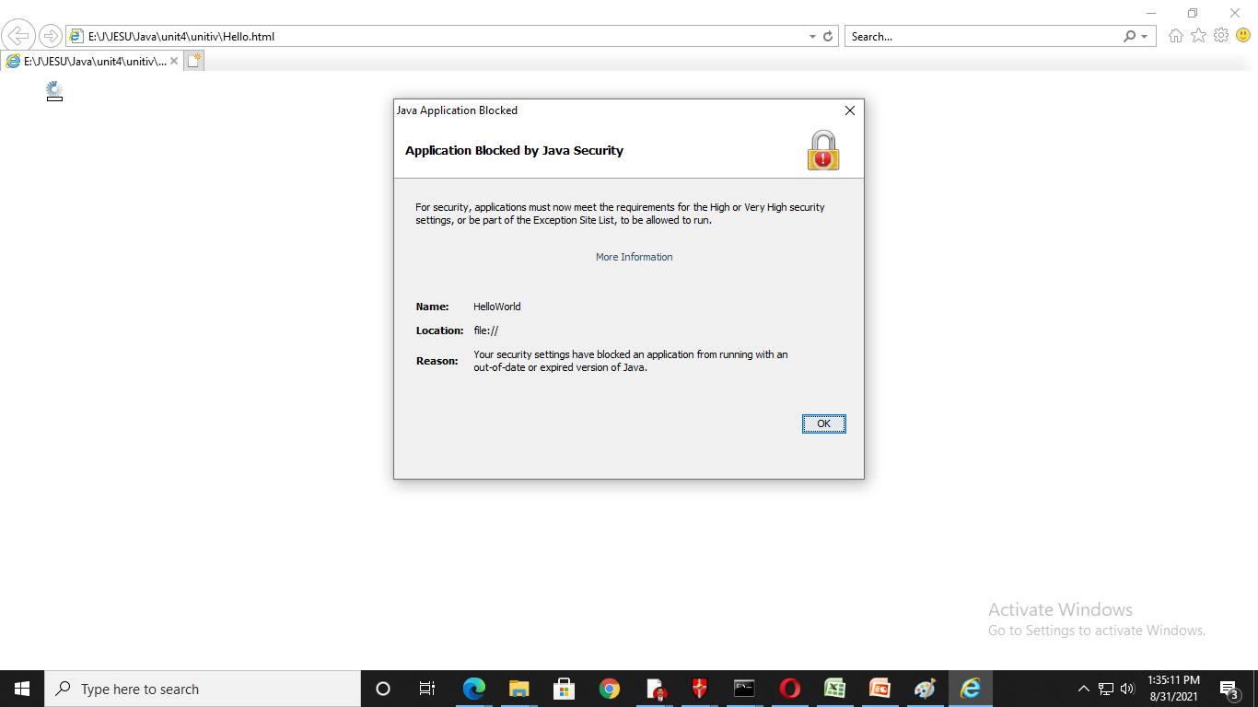
SITA2301 Programming in Java - III Sem CSE (2020-2024) Dr. A. Jesudoss, Associate Professor, Dept. of CSE, SIST, Chennai

Slide 32
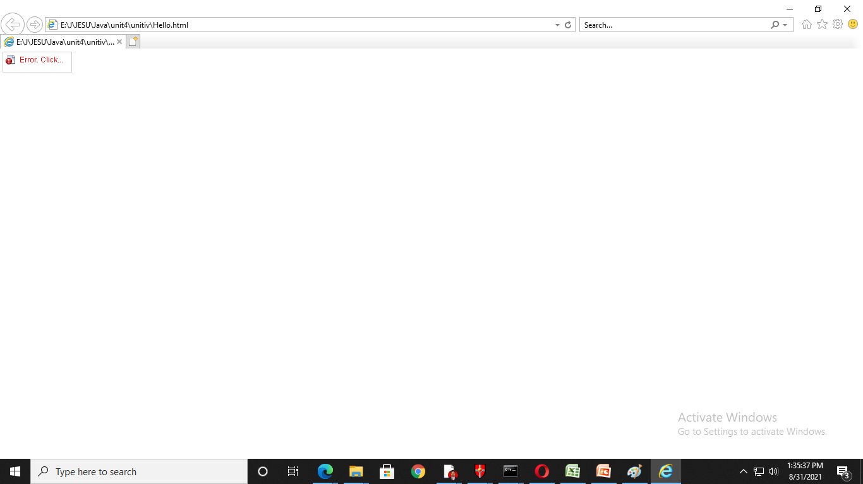
SITA2301 Programming in Java - III Sem CSE (2020-2024) Dr. A. Jesudoss, Associate Professor, Dept. of CSE, SIST, Chennai

Slide 33
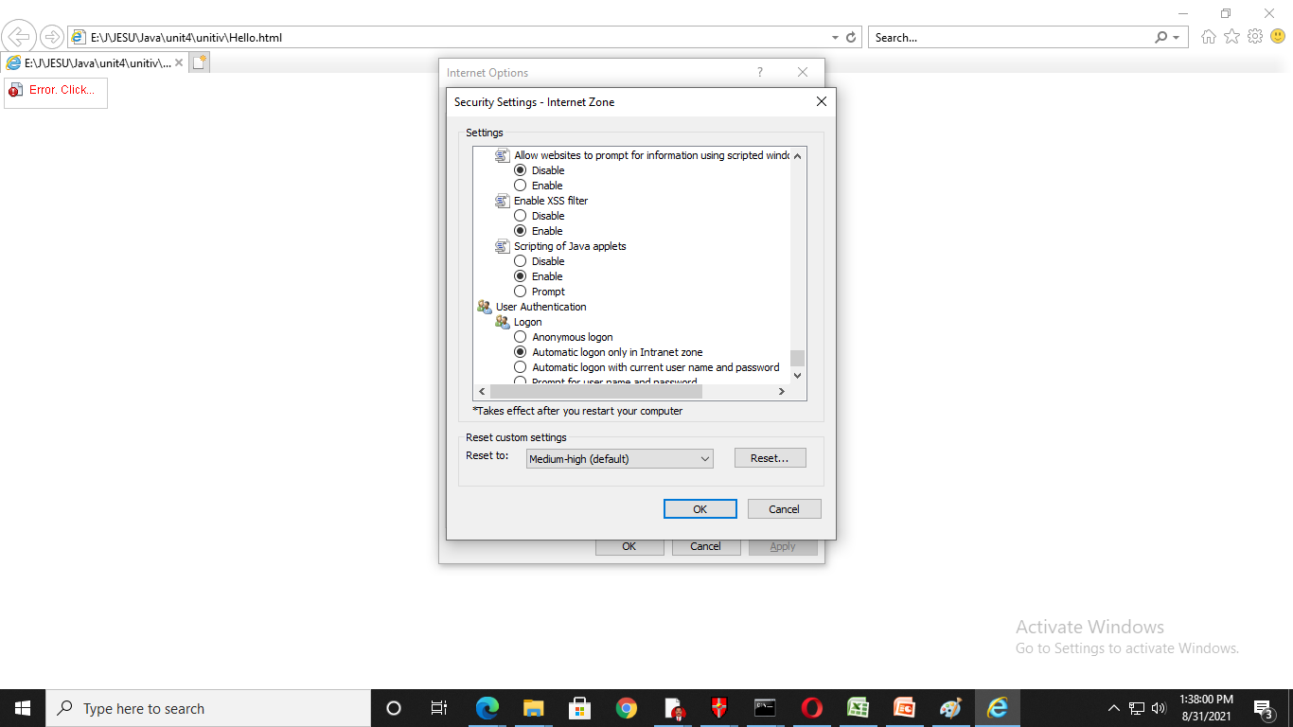
SITA2301 Programming in Java - III Sem CSE (2020-2024) Dr. A. Jesudoss, Associate Professor, Dept. of CSE, SIST, Chennai

Slide 34

SITA2301 Programming in Java - III Sem CSE (2020-2024) Dr. A. Jesudoss, Associate Professor, Dept. of CSE, SIST, Chennai

Slide 35
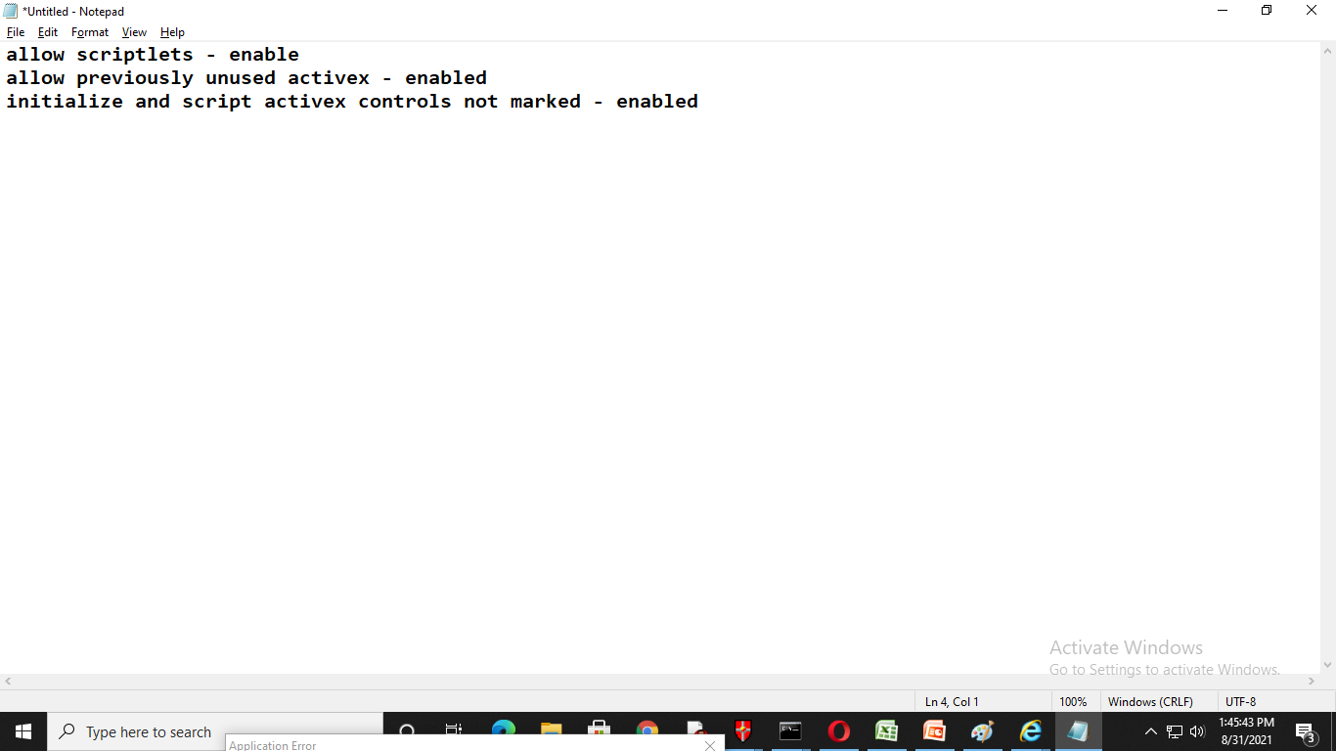
SITA2301 Programming in Java - III Sem CSE (2020-2024) Dr. A. Jesudoss, Associate Professor, Dept. of CSE, SIST, Chennai

Slide 36
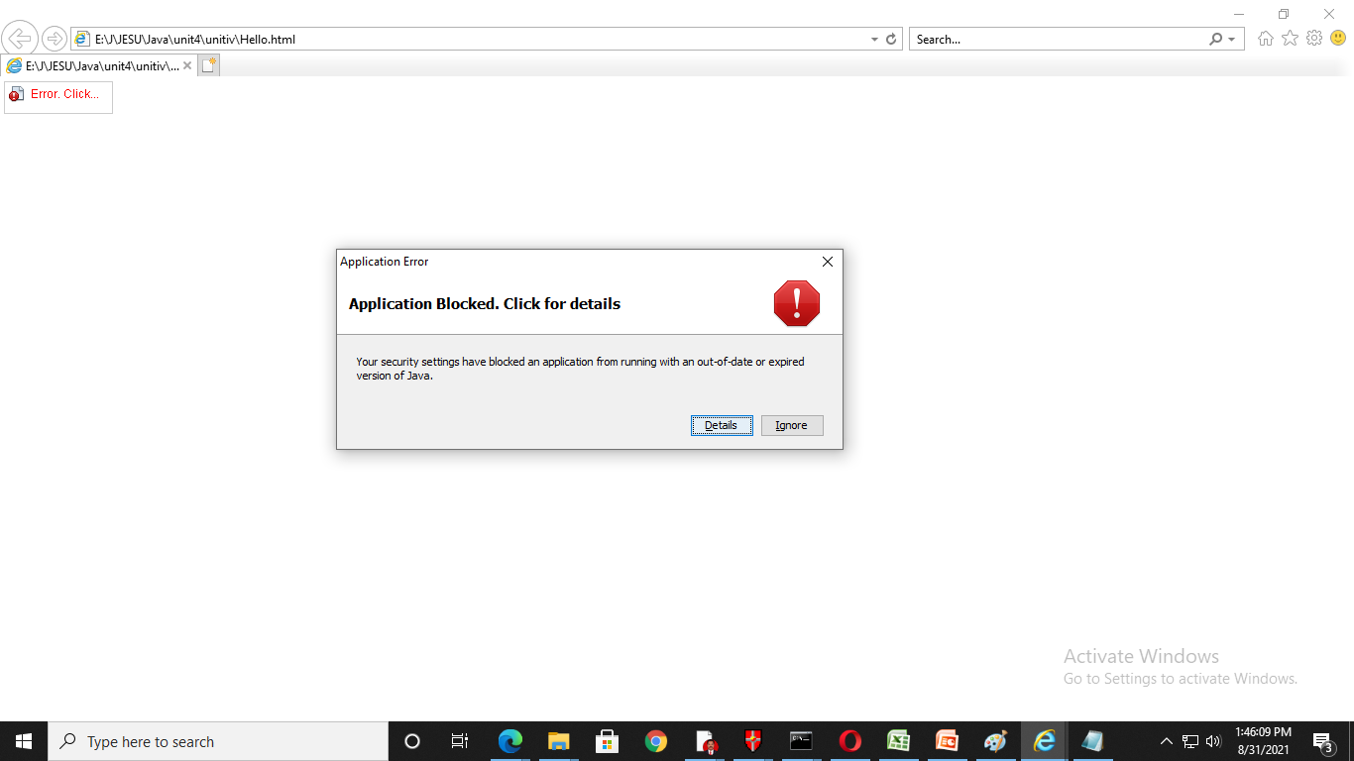
SITA2301 Programming in Java - III Sem CSE (2020-2024) Dr. A. Jesudoss, Associate Professor, Dept. of CSE, SIST, Chennai

Slide 37
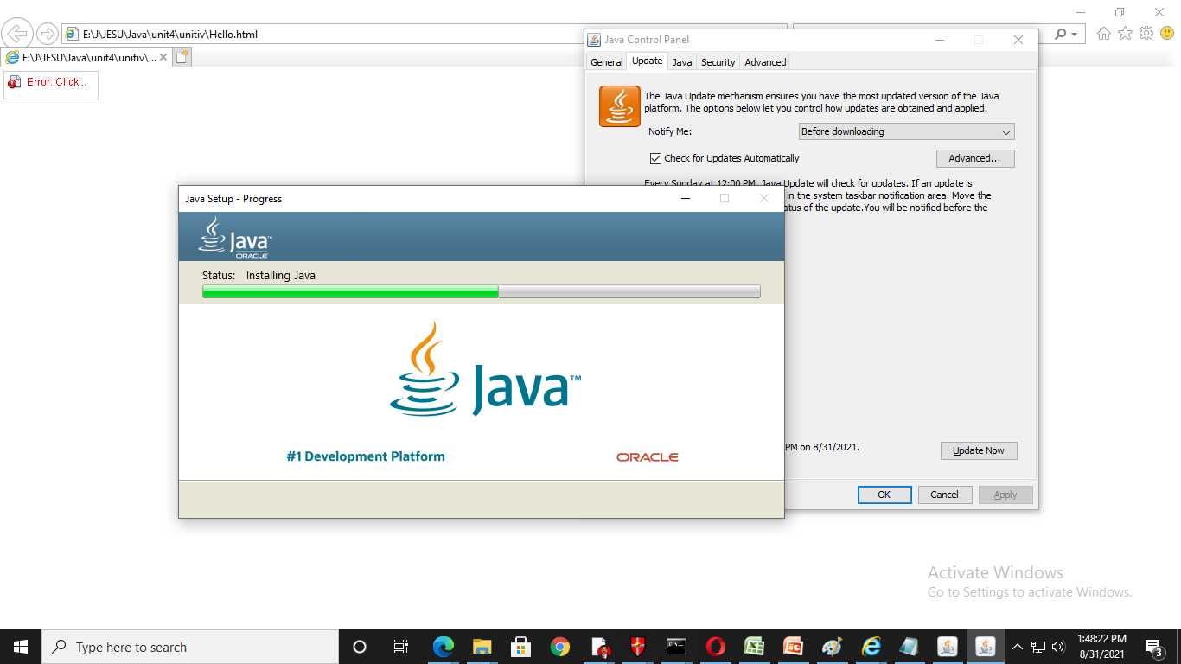
SITA2301 Programming in Java - III Sem CSE (2020-2024) Dr. A. Jesudoss, Associate Professor, Dept. of CSE, SIST, Chennai

Slide 38
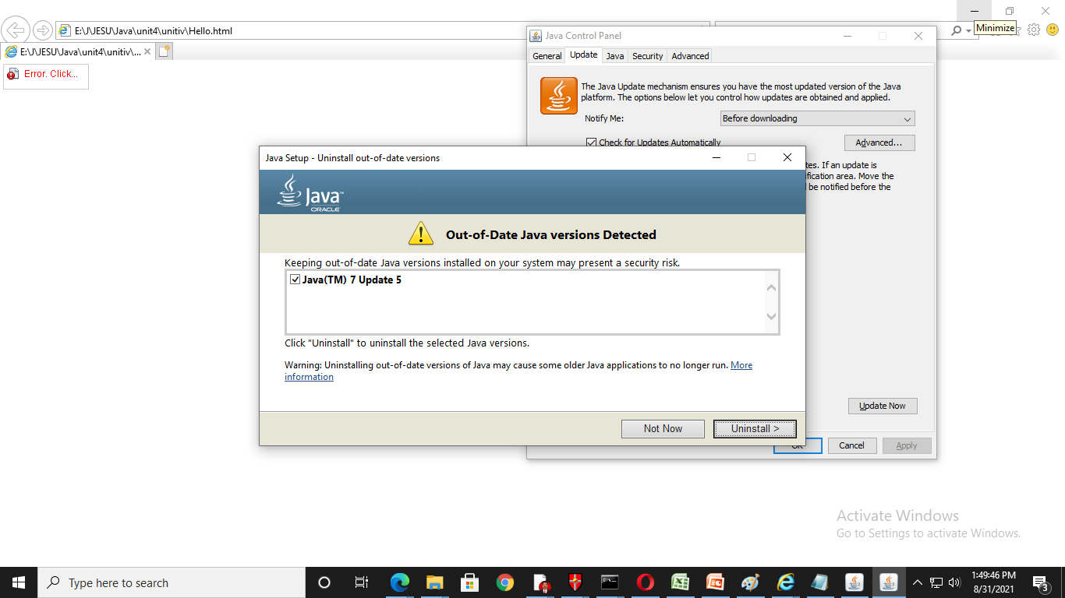
SITA2301 Programming in Java - III Sem CSE (2020-2024) Dr. A. Jesudoss, Associate Professor, Dept. of CSE, SIST, Chennai

Slide 39
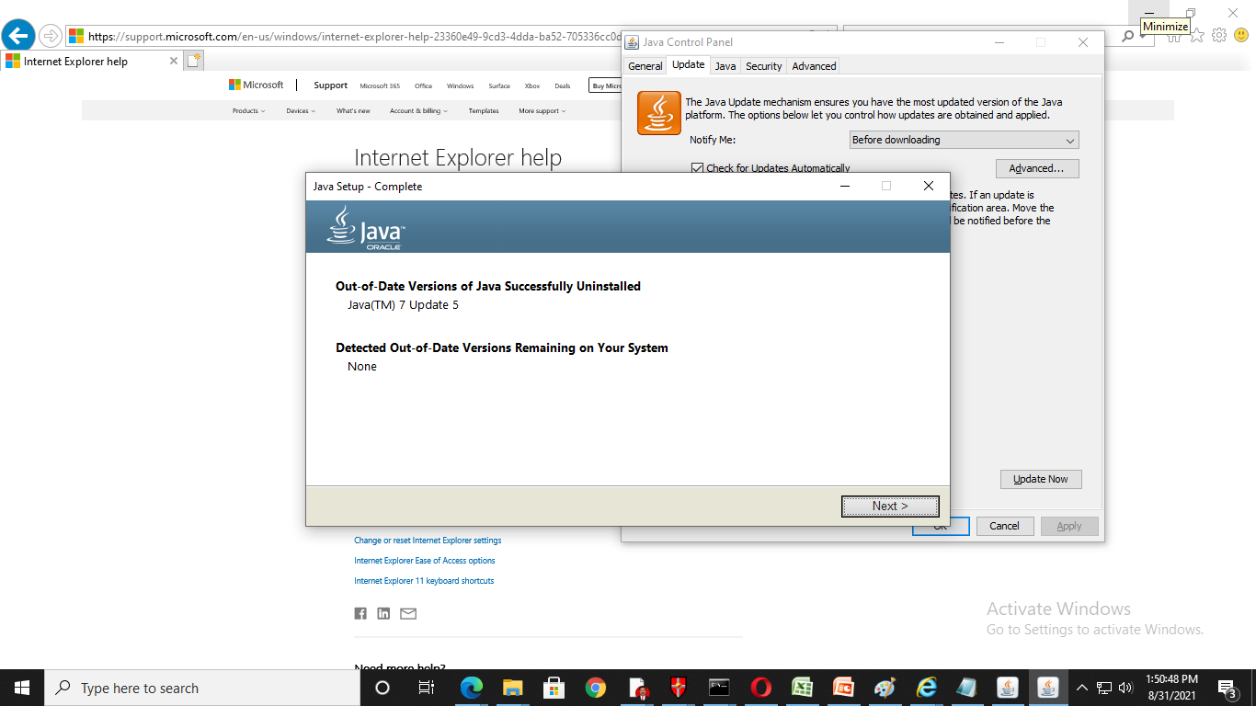
SITA2301 Programming in Java - III Sem CSE (2020-2024) Dr. A. Jesudoss, Associate Professor, Dept. of CSE, SIST, Chennai

Slide 40
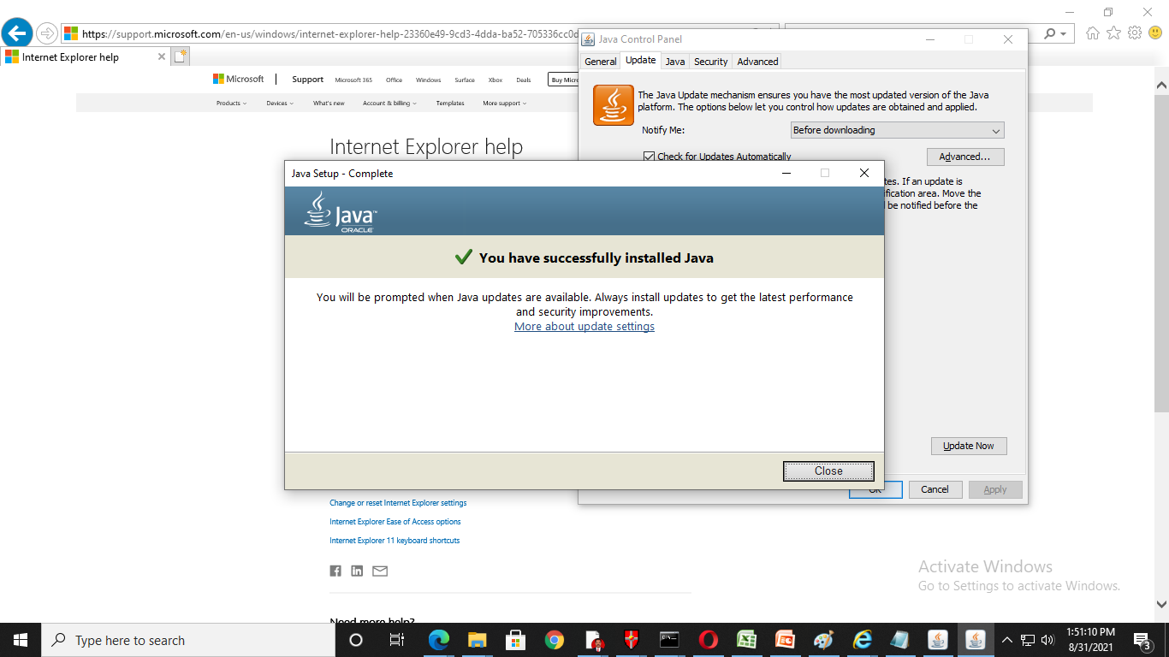
SITA2301 Programming in Java - III Sem CSE (2020-2024) Dr. A. Jesudoss, Associate Professor, Dept. of CSE, SIST, Chennai

Slide 41
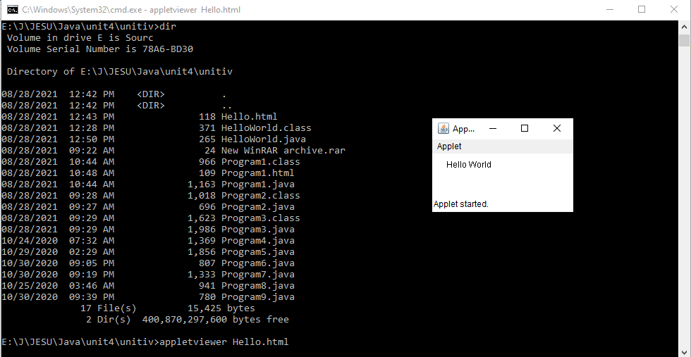
Method 2a: Using appletviewer
C:\>Appletviewer Hello.html
SITA2301 Programming in Java - III Sem CSE (2020-2024) Dr. A. Jesudoss, Associate Professor, Dept. of CSE, SIST, Chennai

Slide 42
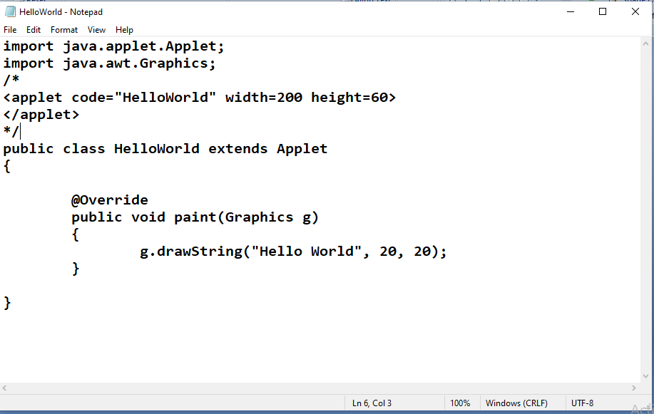
Method 2b: Applet Viewer
Appletviewer HelloWorld.java
SITA2301 Programming in Java - III Sem CSE (2020-2024) Dr. A. Jesudoss, Associate Professor, Dept. of CSE, SIST, Chennai

Slide 43
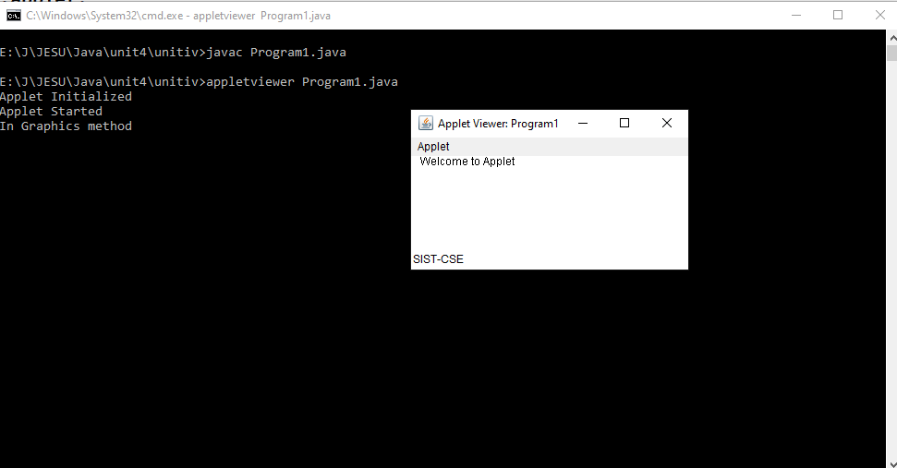
SITA2301 Programming in Java - III Sem CSE (2020-2024) Dr. A. Jesudoss, Associate Professor, Dept. of CSE, SIST, Chennai

Slide 44
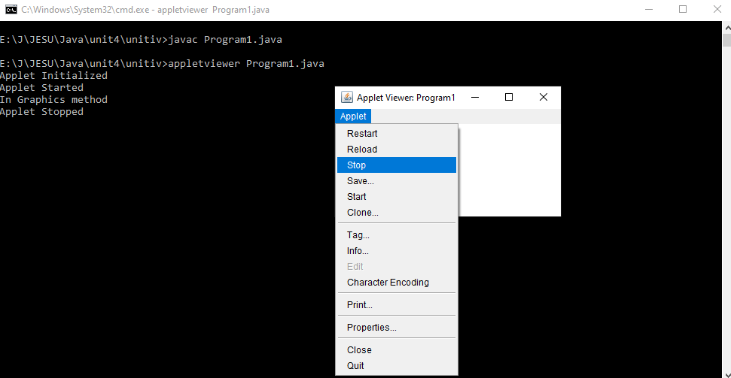
SITA2301 Programming in Java - III Sem CSE (2020-2024) Dr. A. Jesudoss, Associate Professor, Dept. of CSE, SIST, Chennai

Slide 45
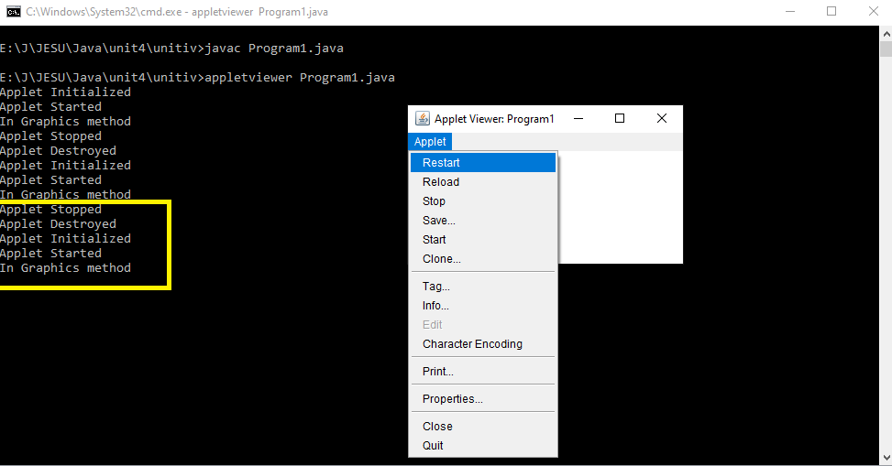
SITA2301 Programming in Java - III Sem CSE (2020-2024) Dr. A. Jesudoss, Associate Professor, Dept. of CSE, SIST, Chennai

Slide 46
Appletviewer with java source file :
If you include a comment at the head of your Java source code file that contains the APPLET tag then your code is documented with a prototype of the necessary HTML statements, and you can run your compiled applet merely by starting the applet viewer with your Java source code file.
SITA2301 Programming in Java - III Sem CSE (2020-2024) Dr. A. Jesudoss, Associate Professor, Dept. of CSE, SIST, Chennai

Slide 47
Features of Applets over HTML
Displaying dynamic web pages of a web application.
Playing sound files.
Displaying documents
Playing animations
Advantages of Applets
Very less response time as it works on the client side.
Can be run using any browser, which has JVM running in it
SITA2301 Programming in Java - III Sem CSE (2020-2024) Dr. A. Jesudoss, Associate Professor, Dept. of CSE, SIST, Chennai

Slide 48
Restrictions imposed on Java applets
Due to security reasons , the following restrictions are imposed on Java applets:
An applet cannot load libraries or define native methods.
An applet cannot ordinarily read or write files on the execution host.
An applet cannot read certain system properties.
An applet cannot make network connections except to the host that it came from.
An applet cannot start any program on the host that’s executing it.
SITA2301 Programming in Java - III Sem CSE (2020-2024) Dr. A. Jesudoss, Associate Professor, Dept. of CSE, SIST, Chennai

Slide 49
Differences between an applet and Java application
An applet is a Java class that extends the java.applet.Applet class.
A main() method is not invoked on an applet, and an applet class will not define
main().
Applets are designed to be embedded within an HTML page.
When a user views an HTML page that contains an applet, the code for the
applet is downloaded to the user's machine.
A JVM is required to view an applet. The JVM can be either a plug-in of the Web
browser or a separate runtime environment.
The JVM on the user's machine creates an instance of the applet class and
invokes various methods during the applet's lifetime.
Applets have strict security rules that are enforced by the Web browser.
The security of an applet is often referred to as sandbox security, comparing the
applet to a child playing in a sandbox with various rules that must be followed.
Other classes that the applet needs can be downloaded in a single Java Archive
(JAR) file.
SITA2301 Programming in Java - III Sem CSE (2020-2024) Dr. A. Jesudoss, Associate Professor, Dept. of CSE, SIST, Chennai

Slide 50
Example of an Applet Skeleton
import java.awt.*;
import java.applet.*;
public class AppletTest extends Applet
{
public void init()
{
//initialization
}
public void start ()
{
//start or resume execution
}
public void stop()
{
//suspend execution
}
public void destroy()
{
//perform shutdown activity
}
public void paint (Graphics g)
{
//display the content of window
}
}
SITA2301 Programming in Java - III Sem CSE (2020-2024) Dr. A. Jesudoss, Associate Professor, Dept. of CSE, SIST, Chennai

Slide 51
MyApplet.java
import java.applet.*;
import java.awt.*;
/*
<applet code="MyApplet" width=400 height=400>
</applet>
*/
public class MyApplet extends Applet
{
public void paint(Graphics g)
{
g.setColor(Color.red);
g.drawRect(100,100,50,50);
}
}
SITA2301 Programming in Java - III Sem CSE (2020-2024) Dr. A. Jesudoss, Associate Professor, Dept. of CSE, SIST, Chennai

Slide 52
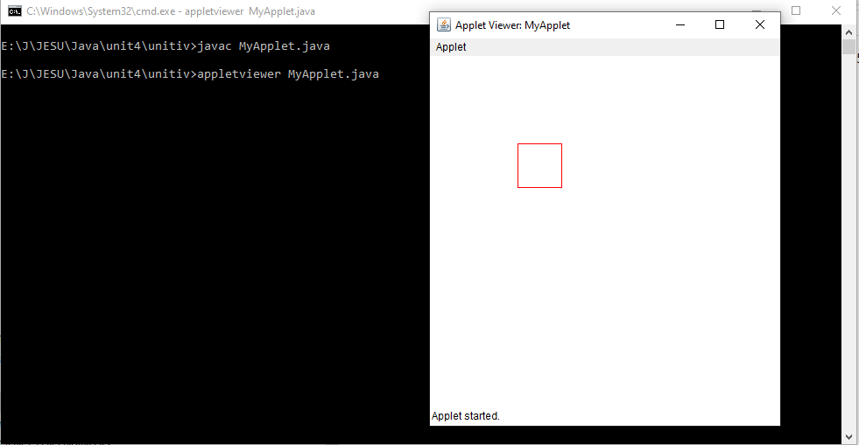
SITA2301 Programming in Java - III Sem CSE (2020-2024) Dr. A. Jesudoss, Associate Professor, Dept. of CSE, SIST, Chennai

Slide 53
Addition.java
//Add two numbers In Applet with HTML
import java.awt.*;
import java.applet.*;
/*
<applet code="Addition" width=400 height=400>
</applet> */
public class Addition extends Applet
{
public void paint(Graphics g)
{
int a=10,b=20,c;
String s="";
c=a+b;
s="sum"+String.valueOf(c);
g.drawString(s,100,100);
}
}
SITA2301 Programming in Java - III Sem CSE (2020-2024) Dr. A. Jesudoss, Associate Professor, Dept. of CSE, SIST, Chennai

Slide 54
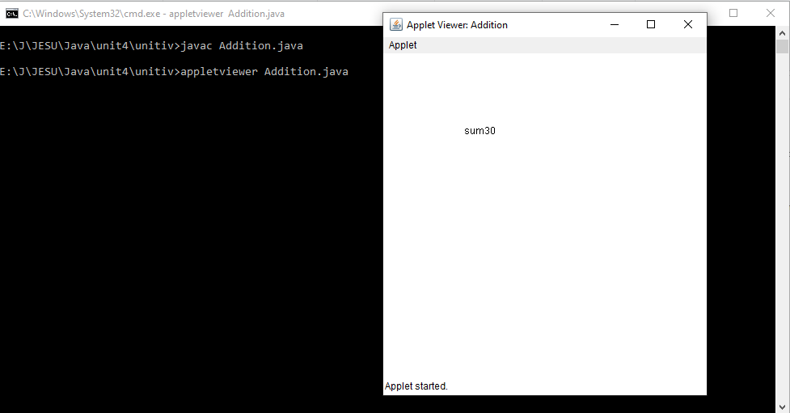
SITA2301 Programming in Java - III Sem CSE (2020-2024) Dr. A. Jesudoss, Associate Professor, Dept. of CSE, SIST, Chennai

Slide 55
Displaying Graphics in Applet
java.awt.Graphics class provides many methods for graphics programming.
Commonly used methods of Graphics class:
1. public abstract void drawString(String str, int x, int y): is used to draw the
specified string.
2. public void drawRect(int x, int y, int width, int height): draws a rectangle with
the specified width and height.
3. public abstract void fillRect(int x, int y, int width, int height): is used to fill
rectangle with the default color and specified width and height.
4. public abstract void drawOval(int x, int y, int width, int height): is used to
draw oval with the specified width and height.
SITA2301 Programming in Java - III Sem CSE (2020-2024) Dr. A. Jesudoss, Associate Professor, Dept. of CSE, SIST, Chennai

Slide 56
6. public abstract void drawLine(int x1, int y1, int x2, int y2): is used to draw
line between the points(x1, y1) and (x2, y2).
7. public abstract boolean drawImage(Image img, int x, int y, ImageObserver
observer): is used draw the specified image. (observer – buffered Image – usually null)
8. public abstract void drawArc(int x, int y, int width, int height, int startAngle,
int arcAngle): is used draw a circular or elliptical arc. Arcangle- no. of degrees around arc
9. public abstract void fillArc(int x, int y, int width, int height, int startAngle,
int arcAngle): is used to fill a circular or elliptical arc.
10.public abstract void setColor(Color c): is used to set the graphics current color to the specified color.
11.public abstract void setFont(Font font): is used to set the graphics current font to the specified font.
SITA2301 Programming in Java - III Sem CSE (2020-2024) Dr. A. Jesudoss, Associate Professor, Dept. of CSE, SIST, Chennai

Slide 57
import java.applet.Applet;
import java.awt.*;
/* <applet code="GraphicsDemo" width=400 height=400>
</applet> */
public class GraphicsDemo extends Applet{
public void paint(Graphics g){
g.setColor(Color.red);
g.drawString("Welcome",50, 50);
g.drawLine(20,30,20,300);
g.drawRect(70,100,30,30);
g.fillRect(170,100,30,30);
g.drawOval(70,200,30,30);
g.setColor(Color.pink);
g.fillOval(170,200,30,30);
g.drawArc(90,150,30,30,30,270);
g.fillArc(270,150,30,30,0,180);
}
}
GraphicsDemo.java
SITA2301 Programming in Java - III Sem CSE (2020-2024) Dr. A. Jesudoss, Associate Professor, Dept. of CSE, SIST, Chennai

Slide 58
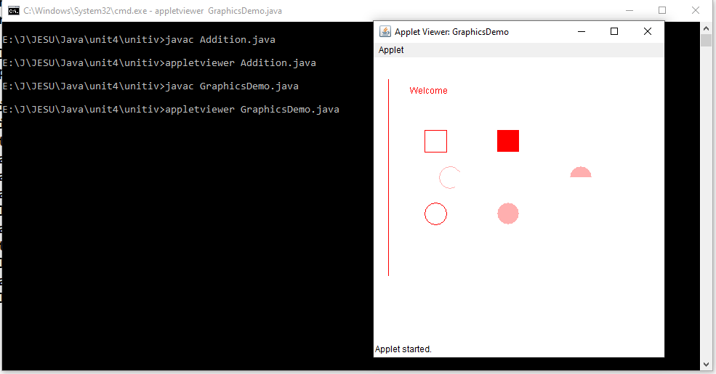
SITA2301 Programming in Java - III Sem CSE (2020-2024) Dr. A. Jesudoss, Associate Professor, Dept. of CSE, SIST, Chennai

Slide 59
Passing Parameters To Applet
We can get any information from the HTML file as a parameter.
For this purpose, Applet class provides a method named getParameter().
SITA2301 Programming in Java - III Sem CSE (2020-2024) Dr. A. Jesudoss, Associate Professor, Dept. of CSE, SIST, Chennai

Slide 60
Parameters.html
<html>
<body>
<applet code="UseParam.class" width="300" height="300">
<param name="msg" value=" Sathyabama University">
</applet>
</body>
</html>
SITA2301 Programming in Java - III Sem CSE (2020-2024) Dr. A. Jesudoss, Associate Professor, Dept. of CSE, SIST, Chennai

Slide 61
UseParam.java
import java.applet.Applet;
import java.awt.Graphics;
public class UseParam extends Applet
{
public void paint(Graphics g)
{
String str=getParameter("msg");
g.drawString(str,50, 50);
}
}
SITA2301 Programming in Java - III Sem CSE (2020-2024) Dr. A. Jesudoss, Associate Professor, Dept. of CSE, SIST, Chennai

Slide 62
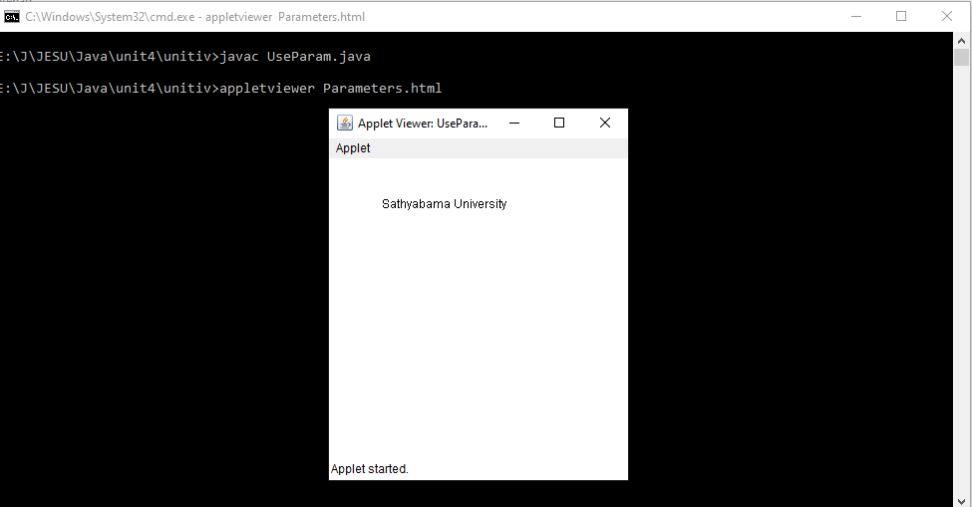
SITA2301 Programming in Java - III Sem CSE (2020-2024) Dr. A. Jesudoss, Associate Professor, Dept. of CSE, SIST, Chennai

Slide 63
Applet Architecture – Use Parameters
import java.awt.*;
import java.applet.*;
/*
<applet code="ParamDemo" width=300 height=80>
<param name=fontName value=Courier>
<param name=fontSize value=14>
<param name=leading value=2>
<param name=accountEnabled value=true>
</applet>
*/
public class ParamDemo extends Applet{
String fontName;
int fontSize;
float leading;
boolean active;
ParamDemo.java
SITA2301 Programming in Java - III Sem CSE (2020-2024) Dr. A. Jesudoss, Associate Professor, Dept. of CSE, SIST, Chennai

Slide 64
// Initialize the string to be displayed.
public void start() {
String param;
fontName = getParameter("fontName");
if(fontName == null)
fontName = "Not Found";
param = getParameter("fontSize");
try {
if(param != null) // if not found
fontSize = Integer.parseInt(param);
else
fontSize = 0;
} catch(NumberFormatException e) {
fontSize = -1;
}
SITA2301 Programming in Java - III Sem CSE (2020-2024) Dr. A. Jesudoss, Associate Professor, Dept. of CSE, SIST, Chennai

Slide 65
param = getParameter("leading");
try {
if(param != null) // if not found
leading = Float.valueOf(param).floatValue();
else
leading = 0;
}
catch(NumberFormatException e)
{
leading = -1;
}
param = getParameter("accountEnabled");
if(param != null)
active = Boolean.valueOf(param).booleanValue();
}
SITA2301 Programming in Java - III Sem CSE (2020-2024) Dr. A. Jesudoss, Associate Professor, Dept. of CSE, SIST, Chennai

Slide 66
public void paint(Graphics g)
{
// Display parameters.
g.drawString("Font name: " + fontName, 0, 10);
g.drawString("Font size: " + fontSize, 0, 26);
g.drawString("Leading: " + leading, 0, 42);
g.drawString("Account Active: " + active, 0, 58);
}
}
SITA2301 Programming in Java - III Sem CSE (2020-2024) Dr. A. Jesudoss, Associate Professor, Dept. of CSE, SIST, Chennai

Slide 67
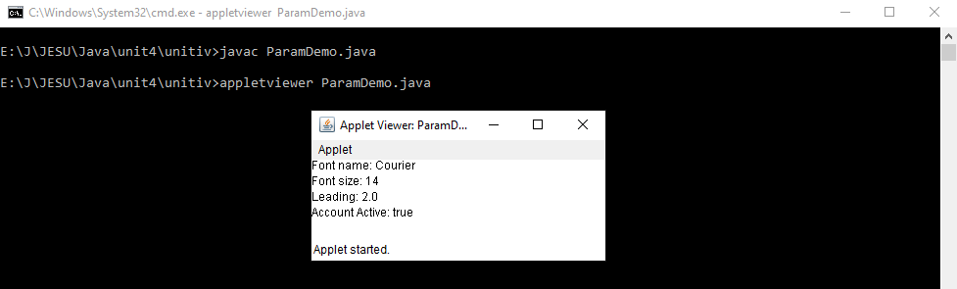
SITA2301 Programming in Java - III Sem CSE (2020-2024) Dr. A. Jesudoss, Associate Professor, Dept. of CSE, SIST, Chennai

Slide 68
Event Handling
What is an Event?
Changing the state of an object is known as an event.
For example, click on button, dragging mouse etc.
The java.awt.event package provides many event classes and Listener interfaces for event handling.
SITA2301 Programming in Java - III Sem CSE (2020-2024) Dr. A. Jesudoss, Associate Professor, Dept. of CSE, SIST, Chennai

Slide 69
Event Classes | Listener Interfaces
ActionEvent | ActionListener
MouseEvent | MouseListener and MouseMotionListener
MouseWheelEvent | MouseWheelListener
KeyEvent | KeyListener
ItemEvent | ItemListener
TextEvent | TextListener
AdjustmentEvent | AdjustmentListener
WindowEvent | WindowListener
ComponentEvent | ComponentListener
ContainerEvent | ContainerListener
FocusEvent | FocusListener
Java Event classes
and
Listener interfaces
SITA2301 Programming in Java - III Sem CSE (2020-2024) Dr. A. Jesudoss, Associate Professor, Dept. of CSE, SIST, Chennai

Slide 70
Steps to perform Event Handling
Following steps are required to perform event handling:
Register the component with the Listener
Registration Methods
For registering the component with the Listener, many classes provide the registration methods. For example:
Button
  public void addActionListener(ActionListener a){}
MenuItem
  public void addActionListener(ActionListener a){}
SITA2301 Programming in Java - III Sem CSE (2020-2024) Dr. A. Jesudoss, Associate Professor, Dept. of CSE, SIST, Chennai

Slide 71
TextField
  public void addActionListener(ActionListener a){}
  public void addTextListener(TextListener a){}
TextArea
  public void addTextListener(TextListener a){}
Checkbox
  public void addItemListener(ItemListener a){}
Choice
  public void addItemListener(ItemListener a){}
List
  public void addActionListener(ActionListener a){}
  public void addItemListener(ItemListener a){}
SITA2301 Programming in Java - III Sem CSE (2020-2024) Dr. A. Jesudoss, Associate Professor, Dept. of CSE, SIST, Chennai

Slide 72
Java Event Handling Code
We can put the event handling code into one of the following places:
Within class
Other class
Anonymous class
SITA2301 Programming in Java - III Sem CSE (2020-2024) Dr. A. Jesudoss, Associate Professor, Dept. of CSE, SIST, Chennai

Slide 73
Java event handling by implementing ActionListener (1. Within Class)
import java.awt.*;
import java.awt.event.*;
public class AEvent extends Frame implements ActionListener{
TextField tf;
public AEvent(){
//create components
tf=new TextField();
tf.setBounds(60,50,170,20);
Button b=new Button("click me");
b.setBounds(100,120,80,30);
//register listener
b.addActionListener(this);//passing current instance
AEvent.java
public void setBounds(int xaxis, int yaxis, int width, int height);
-sets the position of the component it may be button, textfield etc.
SITA2301 Programming in Java - III Sem CSE (2020-2024) Dr. A. Jesudoss, Associate Professor, Dept. of CSE, SIST, Chennai

Slide 74
//add components and set size, layout and visibility
add(b);add(tf);
setSize(300,300); //default size is 0, 0 width, height
setLayout(null);
setVisible(true);
}
public void actionPerformed(ActionEvent e){
tf.setText("Welcome");
}
public static void main(String args[]){
new AEvent();
}
}
SITA2301 Programming in Java - III Sem CSE (2020-2024) Dr. A. Jesudoss, Associate Professor, Dept. of CSE, SIST, Chennai

Slide 75
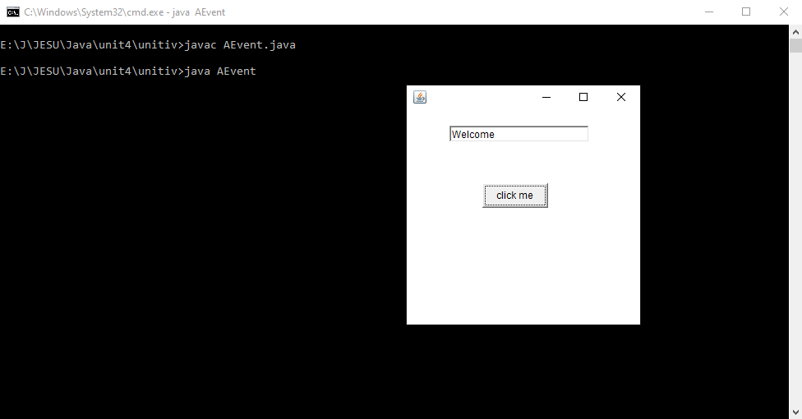
SITA2301 Programming in Java - III Sem CSE (2020-2024) Dr. A. Jesudoss, Associate Professor, Dept. of CSE, SIST, Chennai

Slide 76
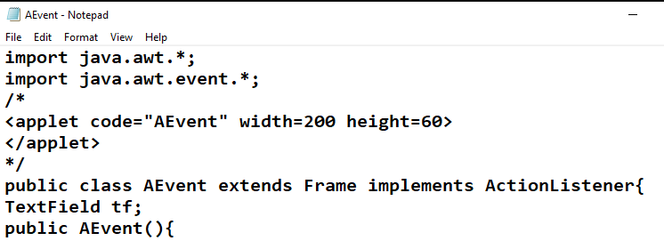
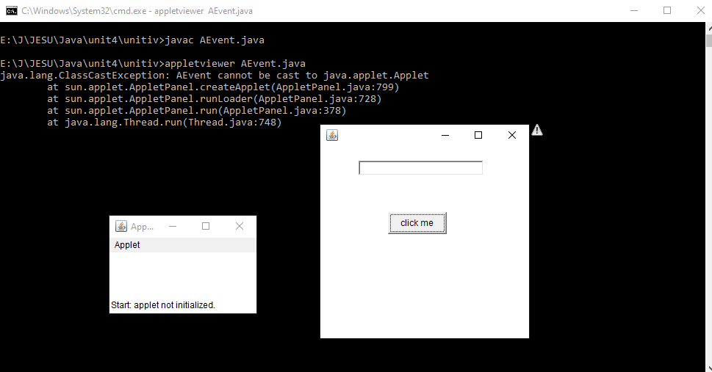
By adding applet tag, you can also run the frames as applets
SITA2301 Programming in Java - III Sem CSE (2020-2024) Dr. A. Jesudoss, Associate Professor, Dept. of CSE, SIST, Chennai

Slide 77
2) Java event handling by outer class
import java.awt.*;
import java.awt.event.*;
class AEvent2 extends Frame
{
TextField tf;
AEvent2()
{
//create components
tf=new TextField();
tf.setBounds(60,50,170,20);
Button b=new Button("click me");
b.setBounds(100,120,80,30);
//register listener
Outer o=new Outer(this);
b.addActionListener(o);//passing outer class instance
//add components and set size, layout and visibility
SITA2301 Programming in Java - III Sem CSE (2020-2024) Dr. A. Jesudoss, Associate Professor, Dept. of CSE, SIST, Chennai

Slide 78
add(b);add(tf);
setSize(300,300);
setLayout(null);
setVisible(true);
}
public static void main(String args[]){
new AEvent2();
}
}
import java.awt.event.*;
class Outer implements ActionListener{
AEvent2 obj;
Outer(AEvent2 obj){
this.obj=obj;
}
public void actionPerformed(ActionEvent e){
obj.tf.setText("welcome");
} }
SITA2301 Programming in Java - III Sem CSE (2020-2024) Dr. A. Jesudoss, Associate Professor, Dept. of CSE, SIST, Chennai

Slide 79
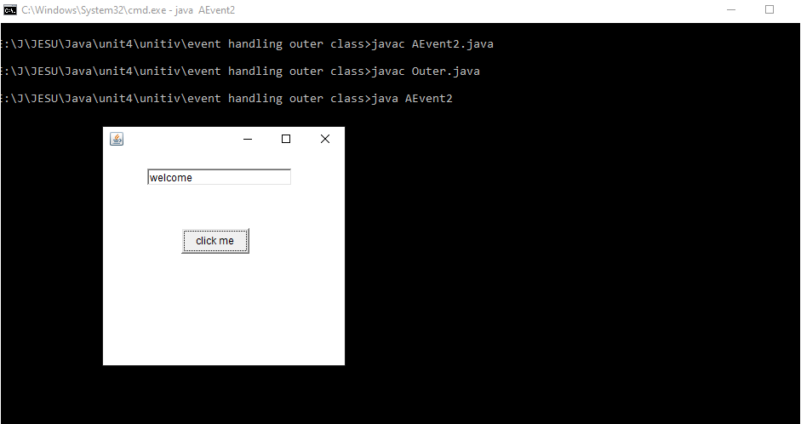
SITA2301 Programming in Java - III Sem CSE (2020-2024) Dr. A. Jesudoss, Associate Professor, Dept. of CSE, SIST, Chennai

Slide 80
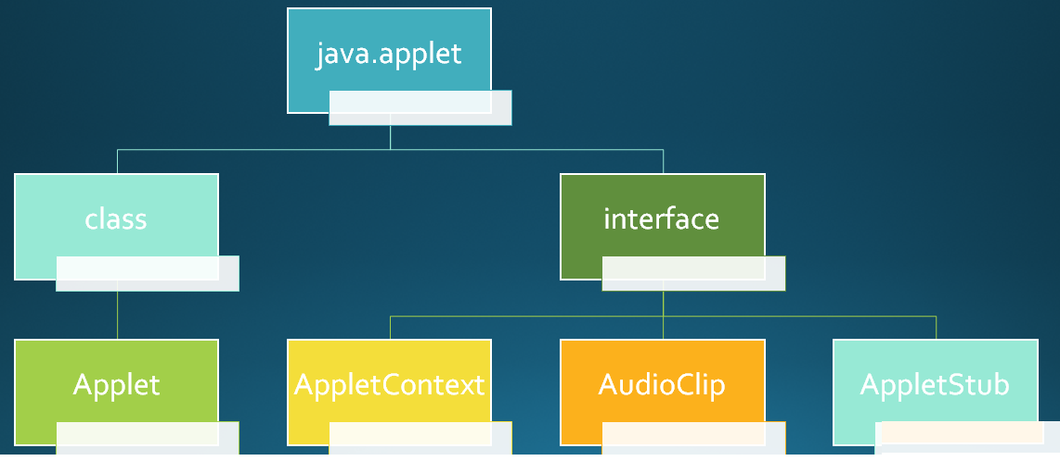
SITA2301 Programming in Java - III Sem CSE (2020-2024) Dr. A. Jesudoss, Associate Professor, Dept. of CSE, SIST, Chennai

Slide 81
AWT
Abstract Windowing Toolkit
an API to develop Graphical User Interface (GUI) or windows-based applications in Java.
Java AWT components are platform-dependent i.e. components are displayed according to the view of operating system.
AWT is heavy weight i.e. its components are using the resources of underlying operating system (OS).
The java.awt package provides classes for AWT API such as TextField, Label, TextArea, RadioButton, CheckBox, Choice, List etc.
SITA2301 Programming in Java - III Sem CSE (2020-2024) Dr. A. Jesudoss, Associate Professor, Dept. of CSE, SIST, Chennai

Slide 82
AWT is platform independent
Java AWT calls the native platform calls the native platform (operating systems) subroutine for creating API components like TextField, ChechBox, button, etc.
For example, an AWT GUI with components like TextField, label and button will have different look and feel for the different platforms like Windows, MAC OS, and Unix.
The reason for this is the platforms have different view for their native components and AWT directly calls the native subroutine that creates those components.
In simple words, an AWT application will look like a windows application in Windows OS whereas it will look like a Mac application in the MAC OS.
SITA2301 Programming in Java - III Sem CSE (2020-2024) Dr. A. Jesudoss, Associate Professor, Dept. of CSE, SIST, Chennai

Slide 83
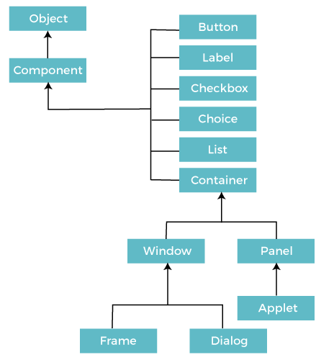
JAVA AWT Hierarchy
SITA2301 Programming in Java - III Sem CSE (2020-2024) Dr. A. Jesudoss, Associate Professor, Dept. of CSE, SIST, Chennai

Slide 84
Component
A component is an object having a graphical representation that can be displayed on the screen and that can interact with the user.
Examples of components are the windows, panels, buttons, checkboxes, scrollbars, lists, menus, and text fields of a typical graphical user interface.
A component is the fundamental user interface object in Java.
Everything you see on the display in a Java application is a component.
To be used, a component usually must be placed in a container.
SITA2301 Programming in Java - III Sem CSE (2020-2024) Dr. A. Jesudoss, Associate Professor, Dept. of CSE, SIST, Chennai

Slide 85
Container
The Container is a component in AWT that can contain another components like buttons, textfields, labels etc.
The classes that extends Container class are known as container such as Frame, Dialog and Panel.
It is basically a screen where the where the components are placed at their specific locations. Thus it contains and controls the layout and positioning of components.
Note: A container itself is a component (see the above diagram), therefore we can add a container inside container. It is a subclass of component
SITA2301 Programming in Java - III Sem CSE (2020-2024) Dr. A. Jesudoss, Associate Professor, Dept. of CSE, SIST, Chennai

Slide 86
Types of containers:
There are four types of containers in Java AWT:
Window
Panel
Frame
Dialog
Window
The window is the container that have no borders and menu bars. You must use frame, dialog or another window for creating a window. We need to create an instance of Window class to create this container.
SITA2301 Programming in Java - III Sem CSE (2020-2024) Dr. A. Jesudoss, Associate Professor, Dept. of CSE, SIST, Chennai

Slide 87
Panel
Concrete subclass of Container
Screen output is drawn on the surface of the Panel.
The Panel is the container that doesn't contain title bar, border or menu bar.
It is generic container for holding the components.
It can have other components like button, text field etc.
An instance of Panel class creates a container, in which we can add components.
SITA2301 Programming in Java - III Sem CSE (2020-2024) Dr. A. Jesudoss, Associate Professor, Dept. of CSE, SIST, Chennai

Slide 88
Frame
The Frame is the container that contain title bar and border and can have menu bars.
It can have other components like button, text field, scrollbar etc.
Frame is most widely used container while developing an AWT application.
SITA2301 Programming in Java - III Sem CSE (2020-2024) Dr. A. Jesudoss, Associate Professor, Dept. of CSE, SIST, Chennai

Slide 89
Useful Methods of Compeonent Class
Method | Description
public void add(Component c) | Inserts a component on this component.
public void setSize(int width,int height) | Sets the size (width and height) of the component.
public void setLayout(LayoutManager m) | Defines the layout manager for the component.
public void setVisible(boolean status) | Changes the visibility of the component, by default false.
SITA2301 Programming in Java - III Sem CSE (2020-2024) Dr. A. Jesudoss, Associate Professor, Dept. of CSE, SIST, Chennai

Slide 90
The Delegation Event Model
The delegation event model defines standard and consistent mechanisms to generate and process events.
Concept of Delegation Event Model
A Source generates an event and sends it to one or more listeners
The Listener simply waits until it receives an event.
Once received, the listener processes the event and then returns
SITA2301 Programming in Java - III Sem CSE (2020-2024) Dr. A. Jesudoss, Associate Professor, Dept. of CSE, SIST, Chennai

Slide 91
EVENTS
An event is an object that describes a state change in a source.
It can be generated By the user interacting with the elements in a graphical user interface.
Ex:
Direct Event: pressing a button, entering a character via the keyboard, selecting an item in a list, and clicking the mouse
In-Direct Event: event may be generated when a timer expires, a counter exceeds a value, a software or hardware failure occurs, or an operation is completed.
SITA2301 Programming in Java - III Sem CSE (2020-2024) Dr. A. Jesudoss, Associate Professor, Dept. of CSE, SIST, Chennai

Slide 92
Event Sources:
A source is an object that generates an event.
A source must register listeners in order for the listeners to receive notifications about a specific type of event.
Each type of event has its own registration method.
Here is the general form:
public void addTypeListener(TypeListener el)
Type - name of the event
el -reference to the event listener
SITA2301 Programming in Java - III Sem CSE (2020-2024) Dr. A. Jesudoss, Associate Professor, Dept. of CSE, SIST, Chennai

Slide 93
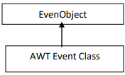
Event Listeners
A listener is an object that is notified when an event occurs.
It has two major requirements.
1. it must have been registered with one or more sources to receive notifications
about specific types of events.
2. it must implement methods to receive and process these notifications.
Event Classes
Eventclass hierarchy
EventObject is the root of all Java event class hierarchy , which is in java.util.
It is the superclass for all events.
SITA2301 Programming in Java - III Sem CSE (2020-2024) Dr. A. Jesudoss, Associate Professor, Dept. of CSE, SIST, Chennai

Slide 94
Subclasses of AWT Event Class
Event Class Description
ActionEvent Generated when a button is pressed, a list item is
double-clicked, or a menu item is selected.
AdjustmentEvent Generated when a scroll bar is manipulated
ComponentEvent Generated when a component is hidden, moved, resized,
or becomes visible.
ContainerEvent Generated when a component is added to or removed
from a container.
FocusEvent Generated when a component gains or loses
keyboard focus.
SITA2301 Programming in Java - III Sem CSE (2020-2024) Dr. A. Jesudoss, Associate Professor, Dept. of CSE, SIST, Chennai

Slide 95
InputEvent Abstract super class for all component input event classes.
ItemEvent Generated when a check box or list item is clicked; also
occurs when a choice selection is made or a checkable
menu item is selected or deselected
KeyEvent Generated when input is received from the keyboard.
MouseEvent Generated when the mouse is dragged, moved, clicked,
pressed, or released; also generated when the mouse enters
or exits a component.
MouseWheelEvent Generated when the mouse wheel is moved
TextEvent Generated when the value of a text area or text field is
changed.
WindowEvent Generated when a window is activated, closed, deactivated, deiconified, iconified, opened, or quit
SITA2301 Programming in Java - III Sem CSE (2020-2024) Dr. A. Jesudoss, Associate Professor, Dept. of CSE, SIST, Chennai

Slide 96
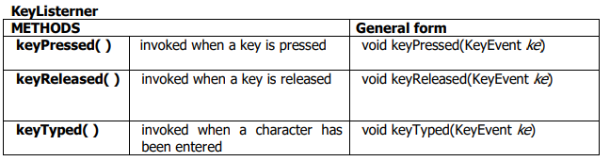
HANDLING KEYBOARD EVENTS
SITA2301 Programming in Java - III Sem CSE (2020-2024) Dr. A. Jesudoss, Associate Professor, Dept. of CSE, SIST, Chennai

Slide 97
import java.awt.*;
import java.awt.event.*;
public class keylistenerx implements KeyListener
{
Frame f;
Label l;
TextArea tf;
TextField td;
String msg="";
keylistenerx()
{
f=new Frame();
l=new Label();
l.setBounds(20,50,100,20);
tf=new TextArea();
td=new TextField();
SITA2301 Programming in Java - III Sem CSE (2020-2024) Dr. A. Jesudoss, Associate Professor, Dept. of CSE, SIST, Chennai

Slide 98
td.setBounds(100,100,70,30);
tf.setBounds(20,80,300,300);
tf.addKeyListener(this);
f.add(l);
f.add(tf);
f.add(td);
f.setSize(400,400);
f.setLayout(null);
f.setVisible(true);
f.addWindowListener(new WindowAdapter()
{
public void windowClosing(WindowEvent e)
{
System.exit(0);
}
});
}
SITA2301 Programming in Java - III Sem CSE (2020-2024) Dr. A. Jesudoss, Associate Professor, Dept. of CSE, SIST, Chennai

Slide 99
public void keyPressed(KeyEvent e)
{
l.setText("keyup");
}
public void keyReleased(KeyEvent e)
{
l.setText("keydown");
}
public void keyTyped(KeyEvent e)
{
l.setText("key typed");
}
public static void main(String args[])
{
new keylistenerx();
}
}
SITA2301 Programming in Java - III Sem CSE (2020-2024) Dr. A. Jesudoss, Associate Professor, Dept. of CSE, SIST, Chennai

Slide 100
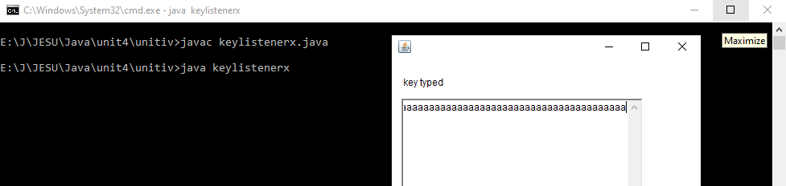
SITA2301 Programming in Java - III Sem CSE (2020-2024) Dr. A. Jesudoss, Associate Professor, Dept. of CSE, SIST, Chennai

Slide 101
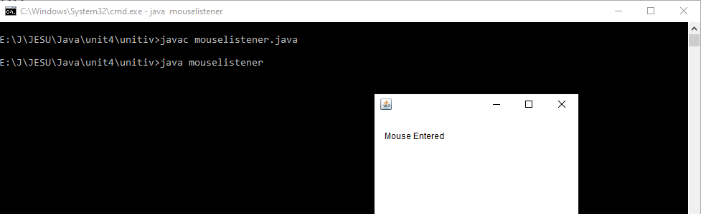
SITA2301 Programming in Java - III Sem CSE (2020-2024) Dr. A. Jesudoss, Associate Professor, Dept. of CSE, SIST, Chennai

Slide 102
Java Adapter Classes
Java adapter classes provide the default implementation of listener interfaces.
If you inherit the adapter class, you will not be forced to provide the implementation of all the methods of listener interfaces.
So it saves code.
The adapter classes are found in java.awt.event, java.awt.dnd and javax.swing.event packages.
The Adapter classes with their corresponding listener interfaces are given below.
SITA2301 Programming in Java - III Sem CSE (2020-2024) Dr. A. Jesudoss, Associate Professor, Dept. of CSE, SIST, Chennai

Slide 103
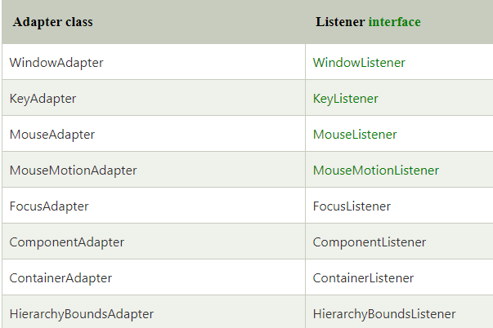
java.awt.event Adapter classes
SITA2301 Programming in Java - III Sem CSE (2020-2024) Dr. A. Jesudoss, Associate Professor, Dept. of CSE, SIST, Chennai

Slide 104
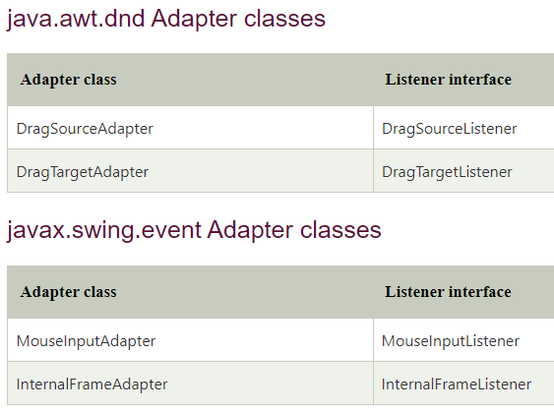
SITA2301 Programming in Java - III Sem CSE (2020-2024) Dr. A. Jesudoss, Associate Professor, Dept. of CSE, SIST, Chennai

Slide 105
SITA2301 Programming in Java - III Sem CSE (2020-2024) Dr. A. Jesudoss, Associate Professor, Dept. of CSE, SIST, Chennai

Slide 106
SITA2301 Programming in Java - III Sem CSE (2020-2024) Dr. A. Jesudoss, Associate Professor, Dept. of CSE, SIST, Chennai

Slide 107
SITA2301 Programming in Java - III Sem CSE (2020-2024) Dr. A. Jesudoss, Associate Professor, Dept. of CSE, SIST, Chennai

Slide 108
SITA2301 Programming in Java - III Sem CSE (2020-2024) Dr. A. Jesudoss, Associate Professor, Dept. of CSE, SIST, Chennai

